Slide 1
POC on CSV to DATABASE insertion using Batch processing

Slide 2

Introduction
This is POC on batch processing, sending millions of records from CSV file to Database insertion through Batch processing.

Slide 3
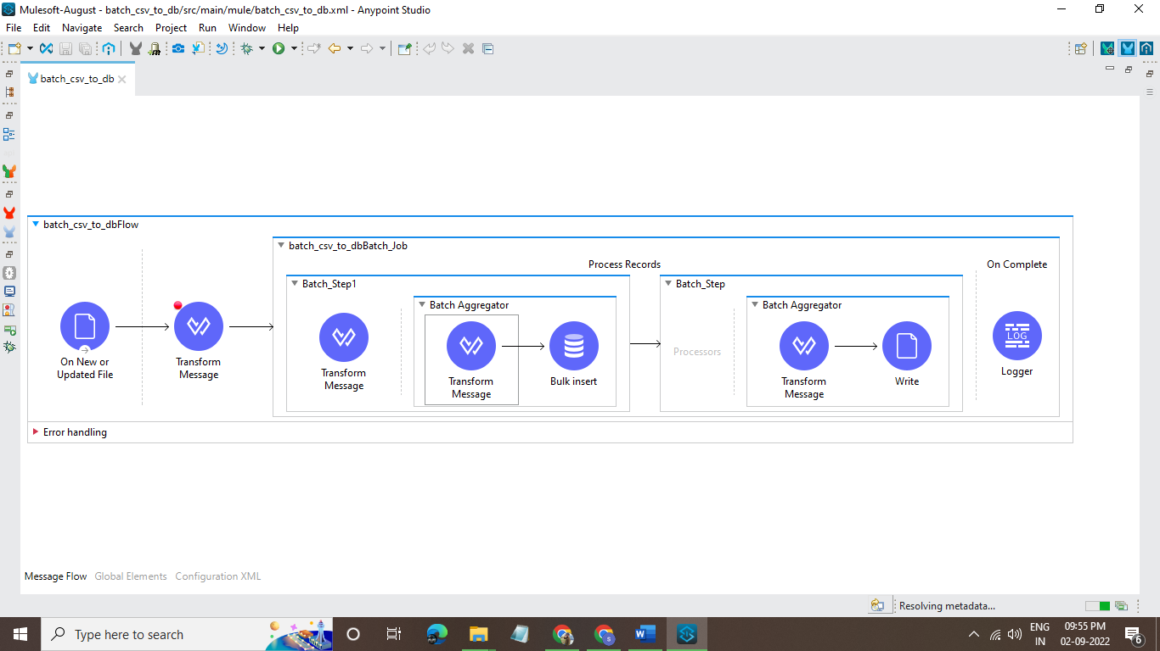
Complete flow:

Slide 4
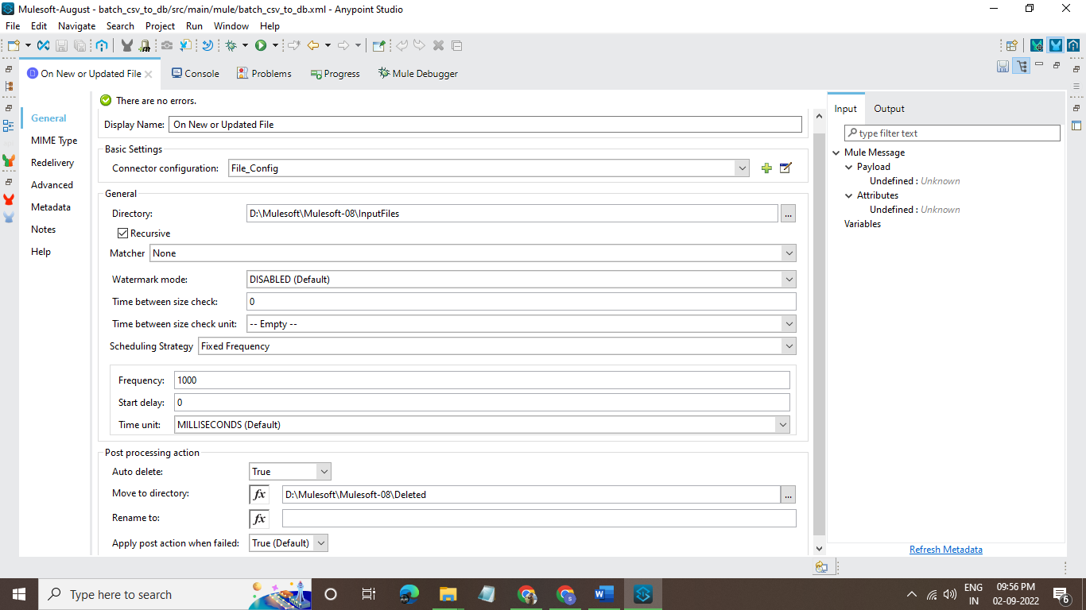
On New or Updated file connector:

Slide 5
On New or Updated file connector:
By using the new or updated connector, it will pick the file whenever the file is
updated or a new file is added to that directory by using a fixed frequency in the
scheduling strategy.
2. After the file is processed, it will also have a post-processing action by using this
we can delete the file and also move it to another directory.

Slide 6
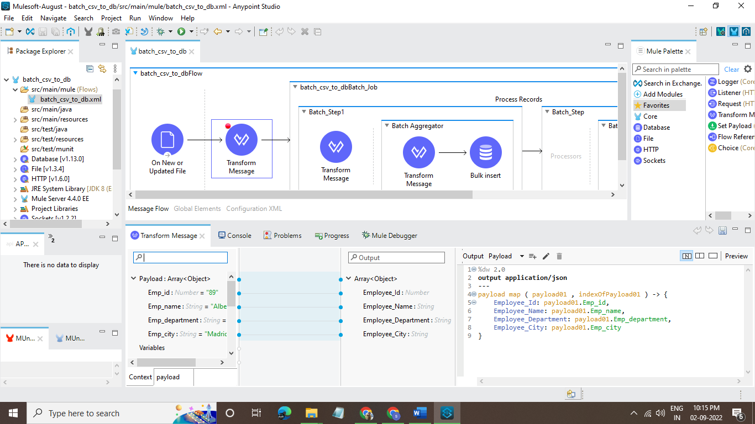
Transform Message connector:

Slide 7
Transform message:
By using this Transform message, we can transform CSV data into JSON data by writing the map function.
After that transformed JAVA payload will load into the batch job.

Slide 8
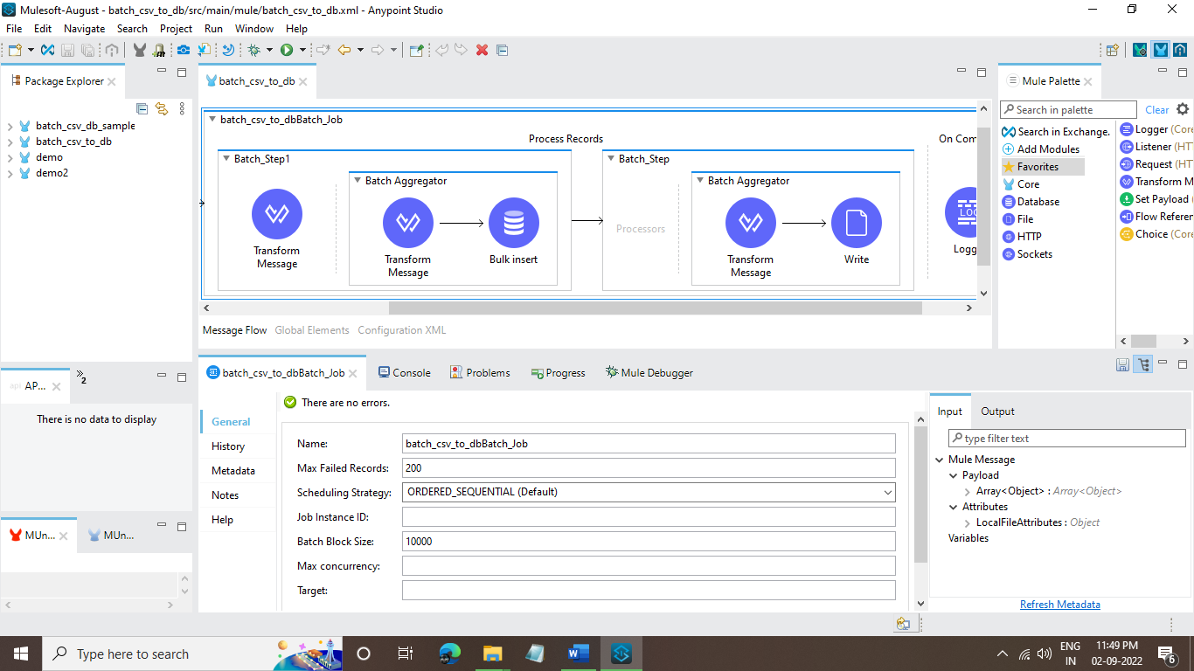
Batch Job connector:

Slide 9
Batch Job connector:
In this batch job connector, we can set the Batch job size as 100.
For every batch job it invokes 16 threads, In each thread will take 100 records and for every batch job it will load 100*16= 1600 records.
By using this we can reduce the processing time.

Slide 10
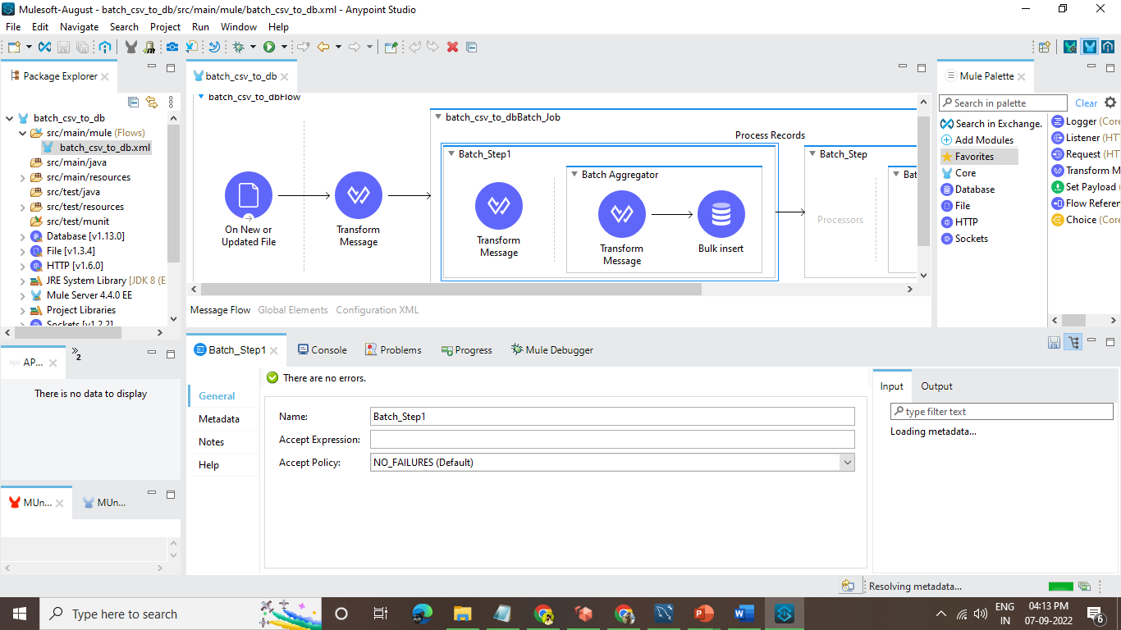
Batch step1:

Slide 11
Batch step1:
In this batch step, we will set Accept policy as No failures.
It will only accept success records.

Slide 12
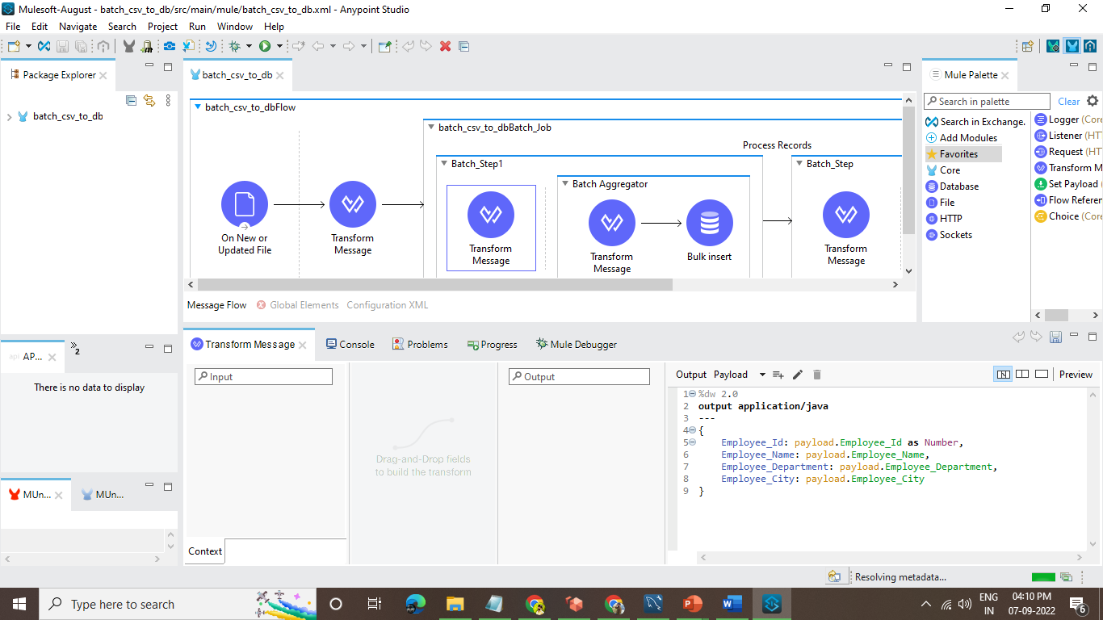
Transform Message:

Slide 13
Transform Message:
By using this Transform message, we can transform an array of JSON data into every single record.
After loading all records, it will proceed into the batch aggregator.

Slide 14
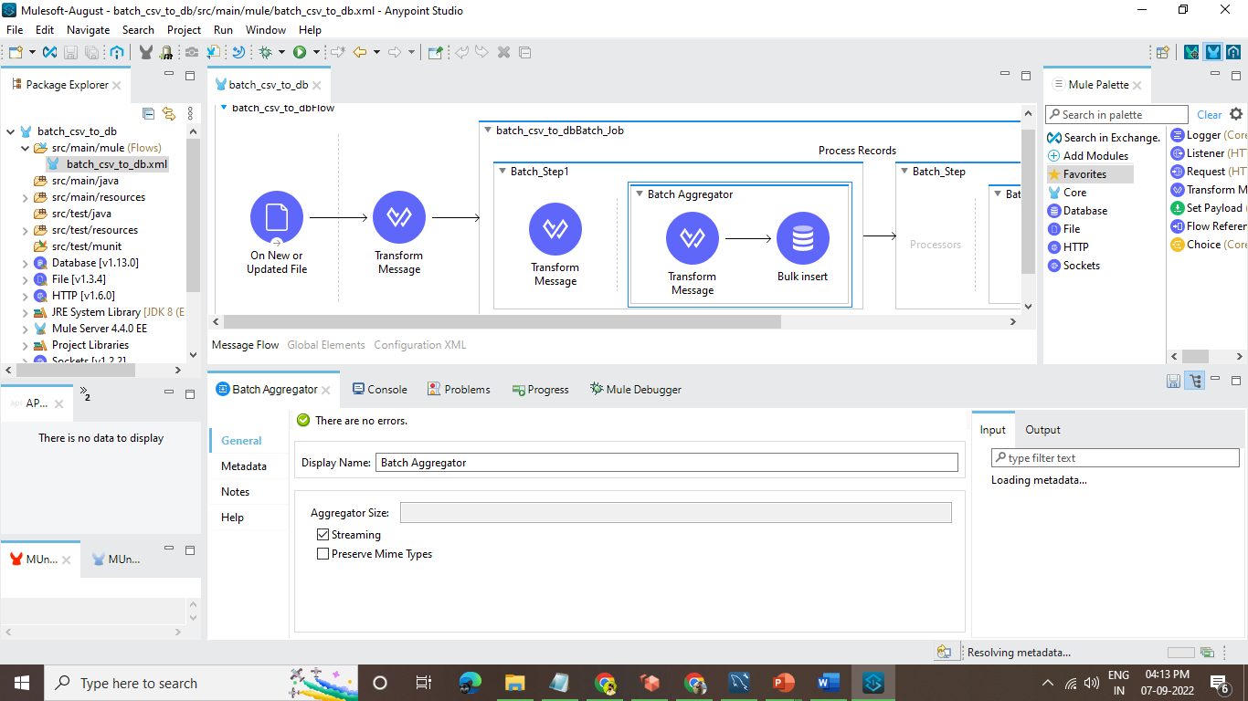
Batch aggregator:

Slide 15
Batch aggregator:
In this batch aggregator, we can set aggregator size as streaming, by using the streaming option it will load all records once and process to the next step.
By using aggregator size like 100,1000,5000 after that specific value is met it will process to the next step.

Slide 16
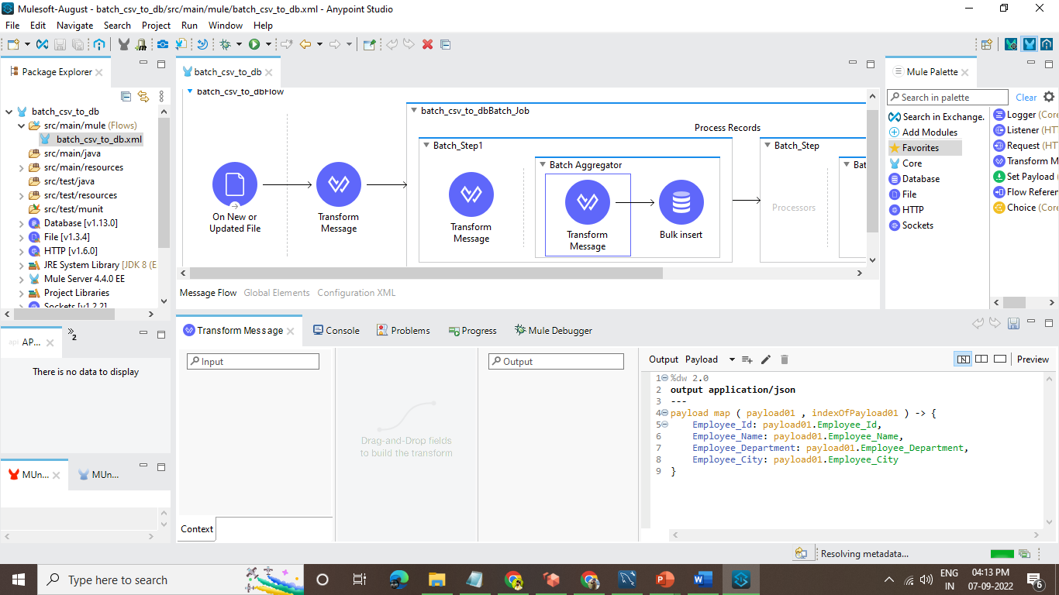
Transform message:

Slide 17
Transform message:
By using this Transform message, we can combine a set of records into an array of records by using the map function.
After completing the process, it will load into the database connector.

Slide 18
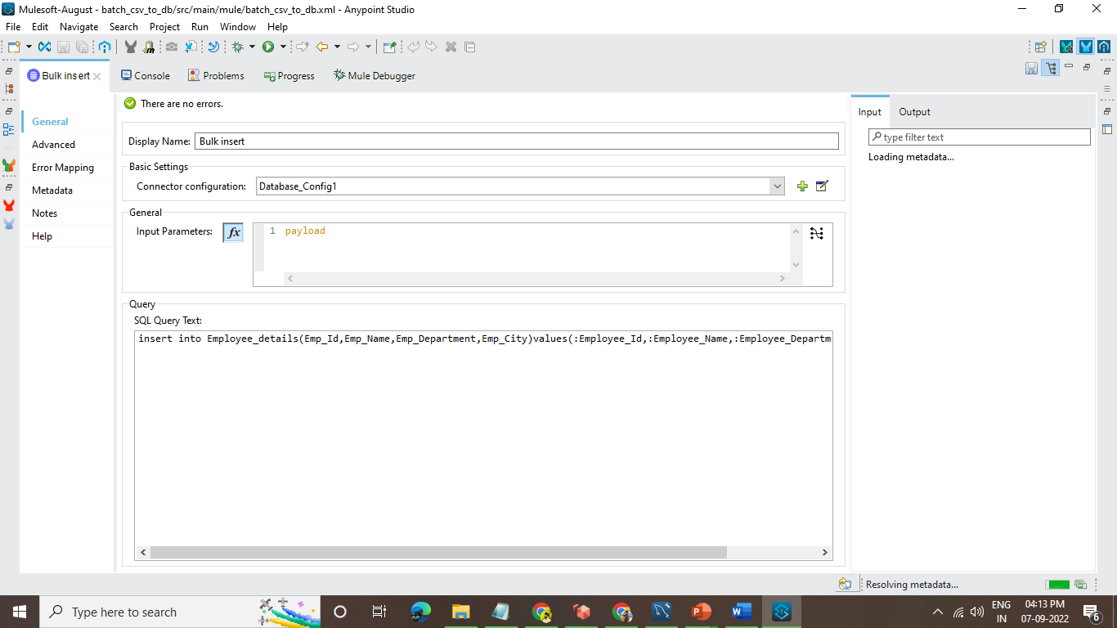
Bulk insert:

Slide 19
Bulk insert:
In this bulk insert connector, we can insert bulk data at a time.
By using the insert query, we can load all the data into the database and insert the data.
By using the below query, we can load data dynamically into the database.
insert into Employee_details(Emp_Id,Emp_Name,Emp_Department,Emp_City)values
(:Employee_Id,:Employee_Name,:Employee_Department,:Employee_City)

Slide 20
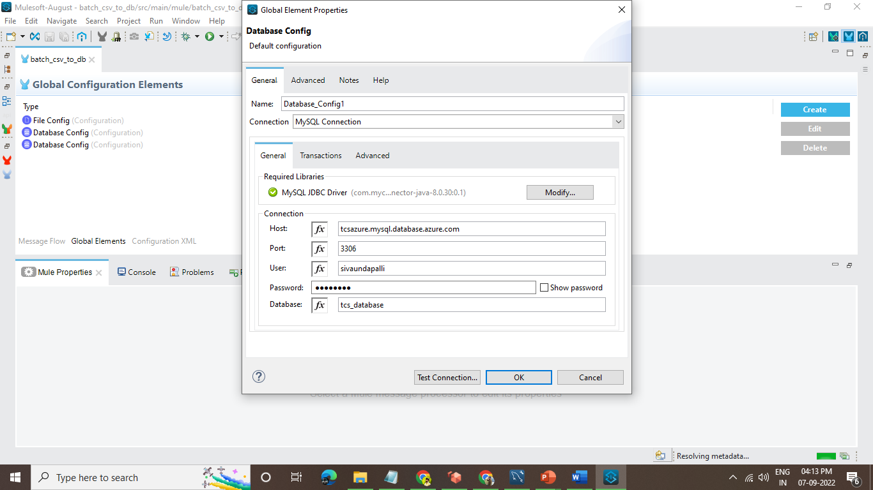
Database configuration:

Slide 21
Database configuration:
By using database configuration, we can connect the Database to insert the data.
By using,
1. Connection – MySQL connection
2. Required libraries – MySQL JDBC driver.
3. Host, port, username, password, database name.

Slide 22
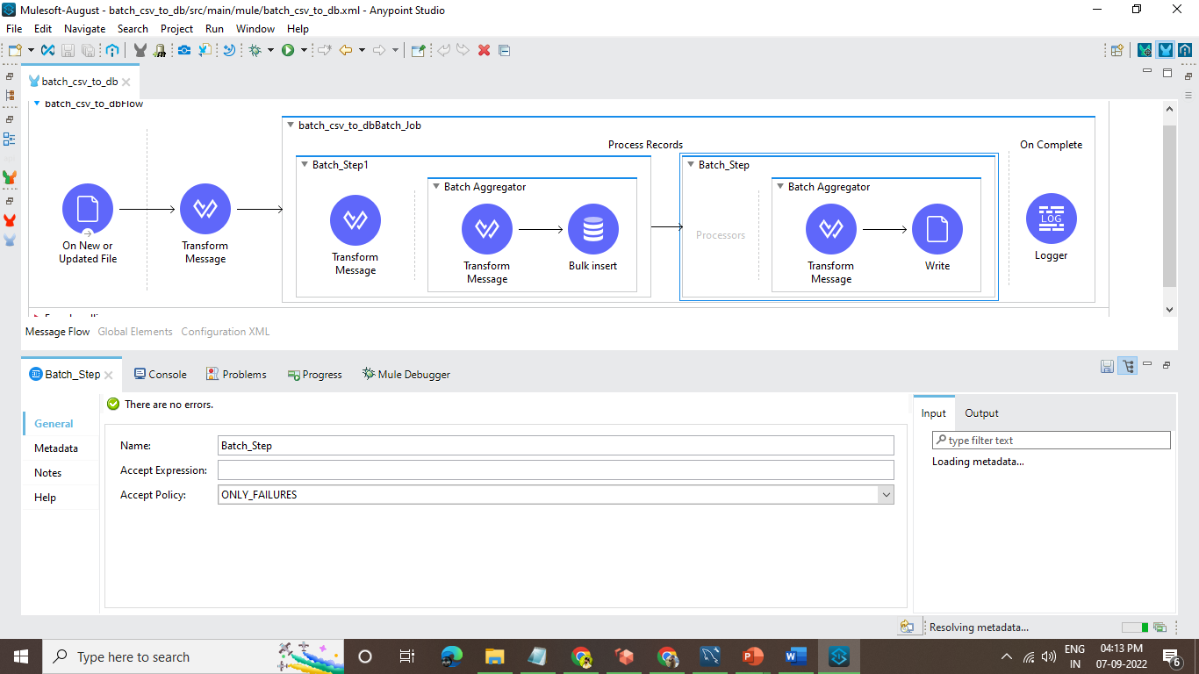
Batch_step: only failures

Slide 23
Batch step:
In this batch step, we will set Accept policy as ONLY FAILURES.
It will only accept records, the records which fail in batch step1 will come here.

Slide 24
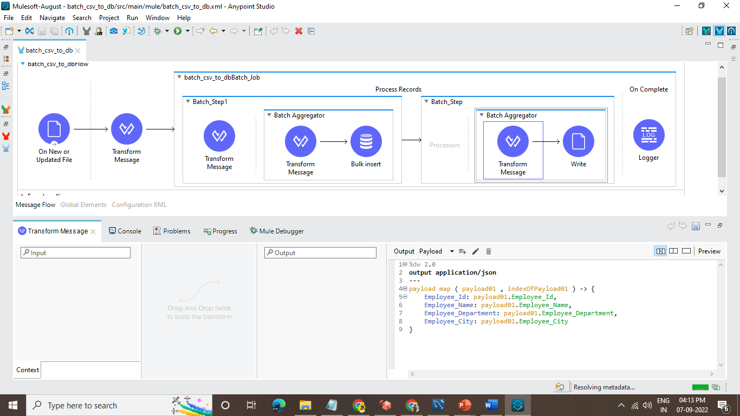
Transform message:

Slide 25
Transform message:
By using this Transform message, we can combine all failed records into an array of records by using the map function.
After completing the process, it will load into the Write file connector.

Slide 26
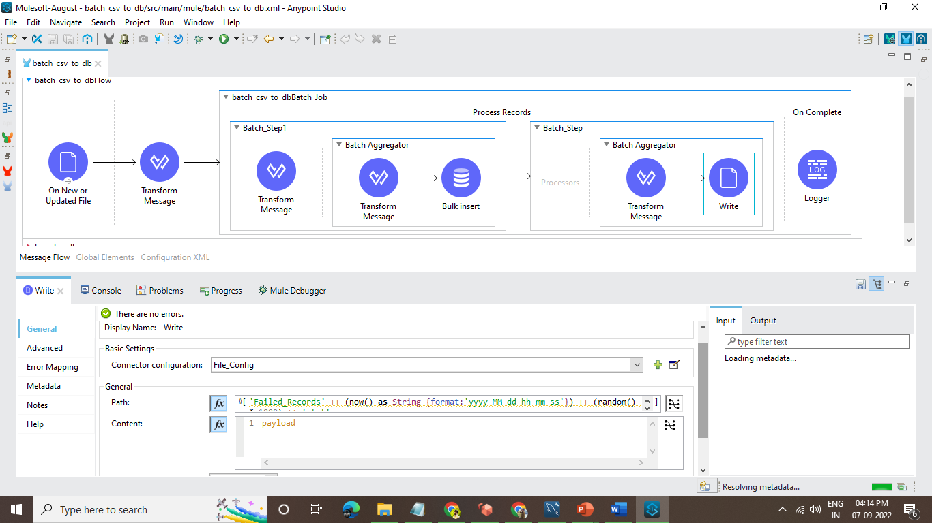
Write:

Slide 27
Write:
By using a write file connector, it will write all the failed records in (.txt) format and save it to the specific directory.
The file path is set as
'Failed_Records' ++ (now() as String {format:'yyyy-MM-dd-hh-mm-ss'}) ++ (random() * 1000) ++ '.txt'

Slide 28
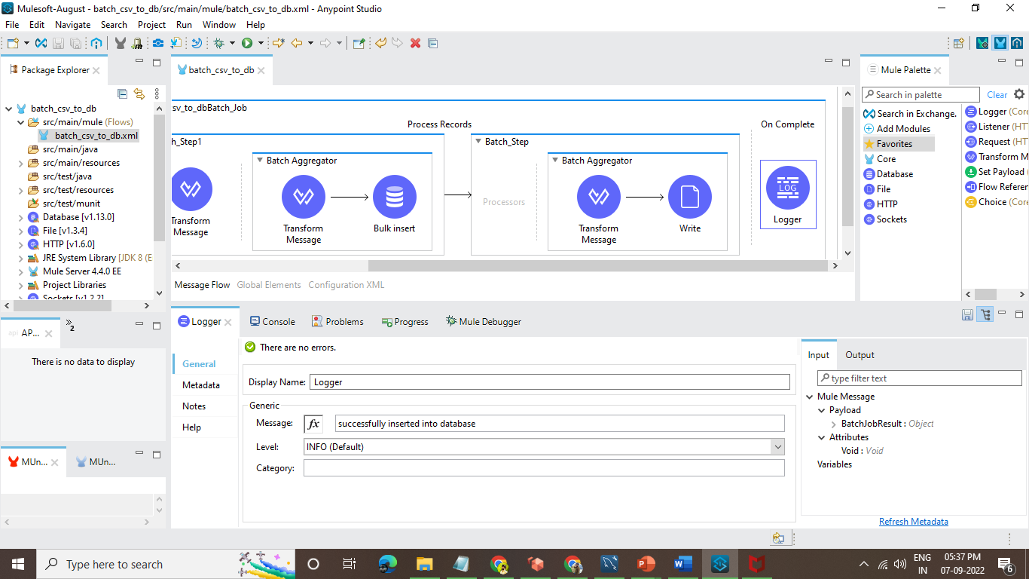
Logger:

Slide 29

This is all about the POC on CSV to Database demo.

Slide 30




Thank you
Siva Undapalli

